Slide 1

Music Night
Grab your headphones — let's share some bangers

Slide 2

Tonight's Lineup
Here's the shape of the evening — three simple phases, maximum good vibes.
Phase 1
Phase 2
Phase 3
Song Presentations
Discussion & Feedback
Spin the Wheel
Up to 10 mins each
Up to 5 mins
Reveal next week's category

Slide 3


Phase 1 of 3
Present Your Song
You have up to 10 minutes — play it, introduce it, and tell us why you picked it.
Play your chosen song (or a key excerpt if it's long)
Give a quick intro: what is it, who's it by, why does it fit the category?
No slides or prep required — just the music and your passion
Up to 10 minutes per participant

Slide 4

Phase 2 — Discussion & Feedback
After each presentation, the group gets 5 minutes to react, connect, and celebrate the pick.
Up to 1 minutes per participant
01
02
03
04
Feel it
Category check
Shout it out
Keep it kind
What did the song make you feel?
Did it fit the category — or bend it in an interesting way?
Shout out something you loved about the pick
Constructive & cheerful — all taste is valid

Slide 5
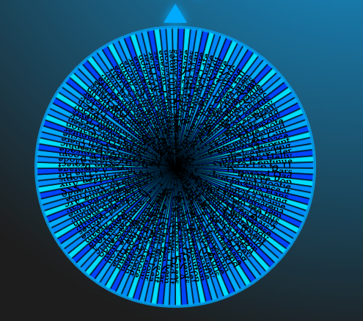
Spin the Wheel
At the end of the night, we spin the wheel to reveal next week's category — and the anticipation begins.
The wheel contains a variety available categories with descriptions
Wherever it lands is next week's theme — each person has 1 veto/skip per week
Start thinking early: the best picks are the ones you've lived with for a week
People can request to add items to the wheel

